Slide 1
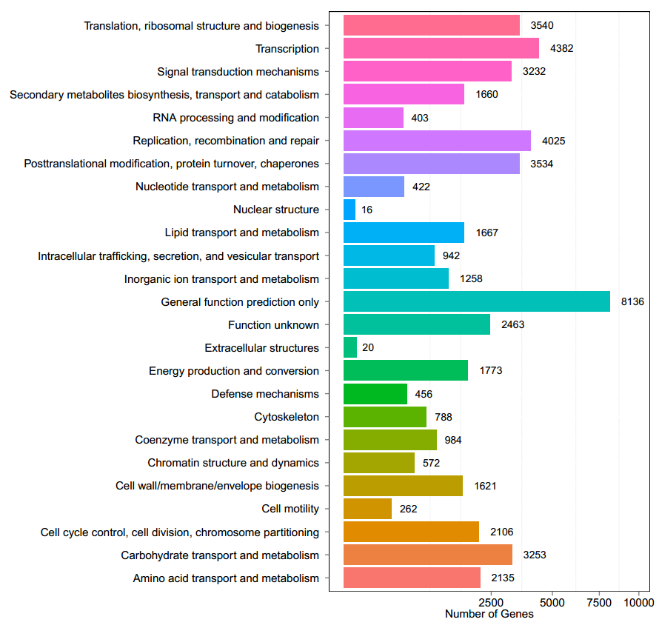
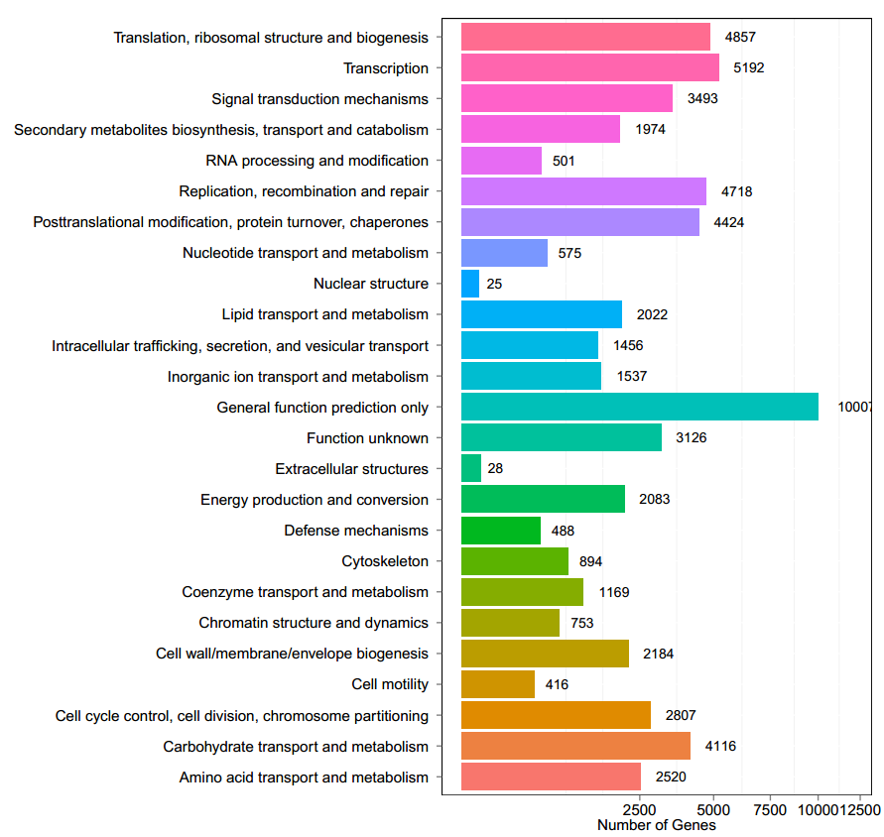
A
B
Supplementary Figure 1 COG Function Classification of German chamomile (A) and Roman chamomile (B)

Slide 2
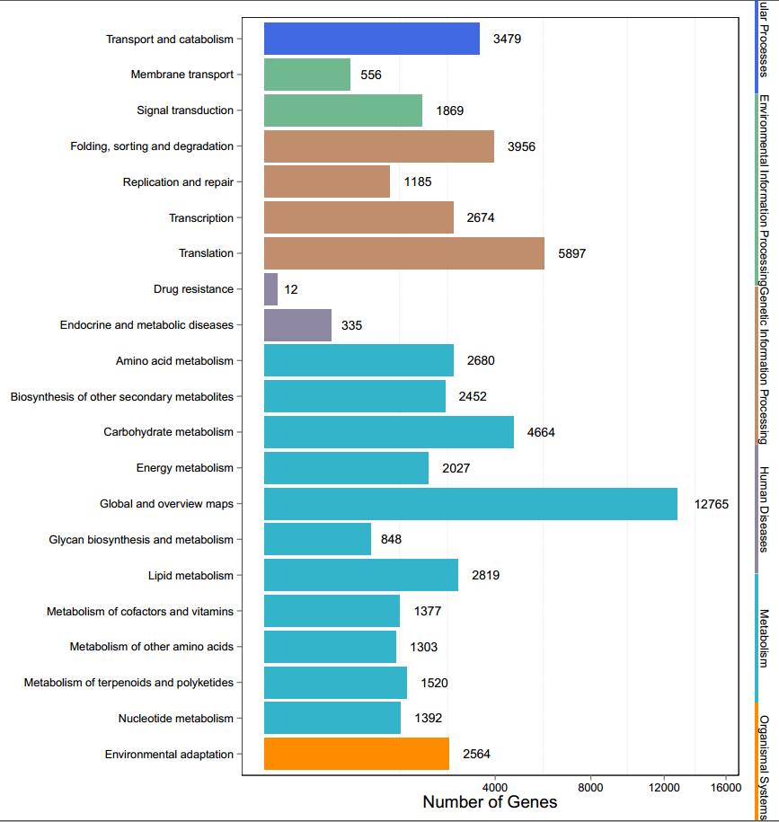
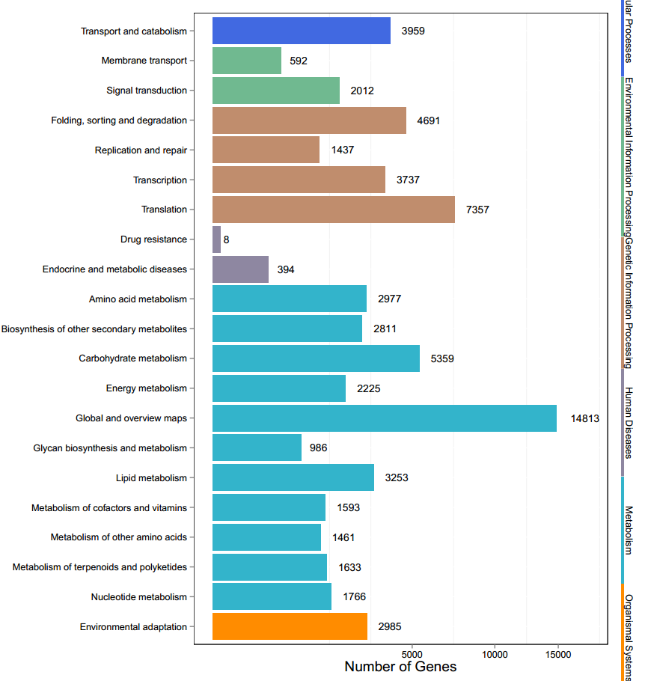
(A)
(B)
Supplementary Figure 2 KEGG Function Classification of German chamomile (A) and Roman chamomile (B)

Slide 3
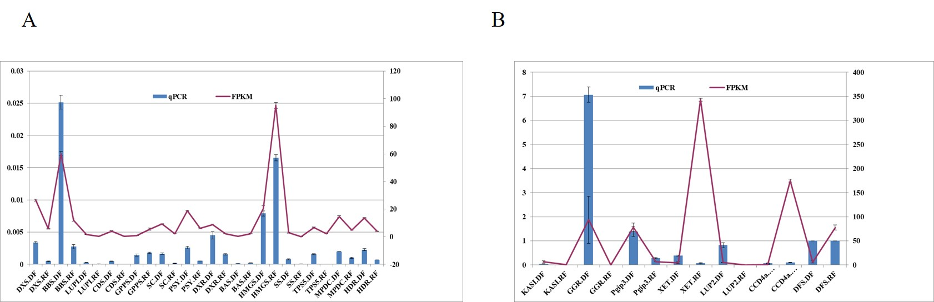
Supplementary Figure 3 Validation of candidate unigenes in the German chamomile (A) and Roman chamomile (B) transcriptomes by qRT-PCR. Gene expression levels were determined by qRT-PCR. Transcription levels are indicated as the mean (2^{ΔCt}) ± SD.

Slide 4
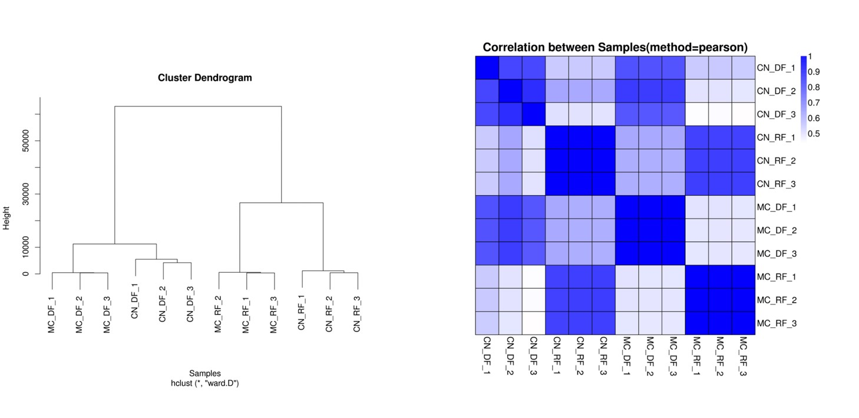
Supplementary Figure 4. Cluster and correlation analyses between German chamomile and Roman chamomile

Slide 5
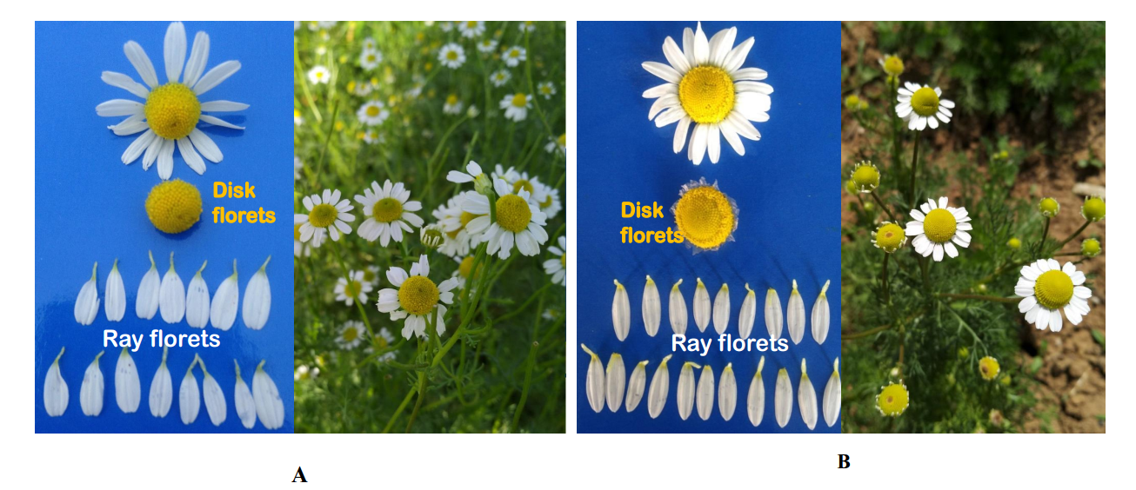
Supplementary Figure 5. Fully open flowers of German chamomile (A) and Roman chamomile (B) dissected to show the disc and ray florets

